Slide 1

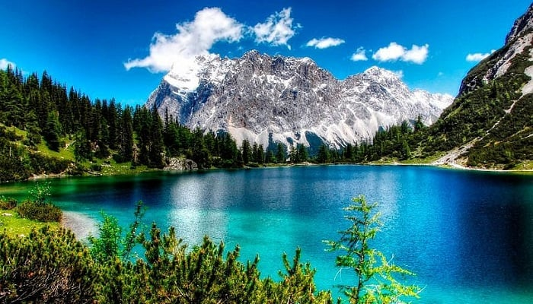
Maestría en Inteligencia Artificial Aplicada
Ciencia y Analítica de Datos
Dr Gilberto Ochoa
Proyecto Final: Métodos de Segmentación Superpixeles
Alberto Nieves Cisneros A01793829
Aurelio Antonio Lozano Rábago A01081266
Héctor Manuel González Villareal A00178679
Jessica Lechuga Ramos A01793512
Luis Alfredo Negron Naldos A01793865

Slide 2
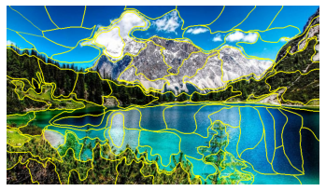
What is Superpixel?
grouping pixels into primitive regions that are more perceptually meaningful than individual pixels

Slide 3
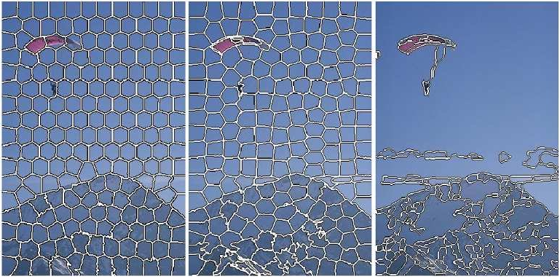
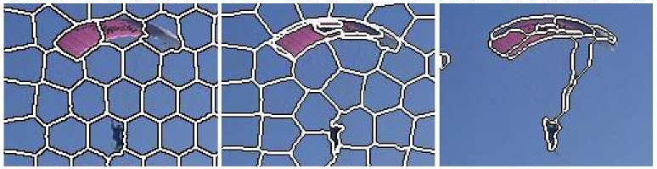
Superpixeles
Advantages
Similar pixel grouping into regions
Dimension reduction (e.g. 400 super pixels instead 600x400)
Computing cost reduction plus improvement on post processing
No square view: adaptation to pixelsa la aplicación
Variable number of pixels according application needs. acorde a la ión

Slide 4
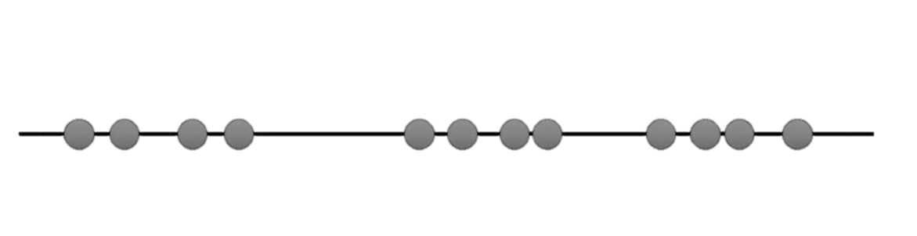
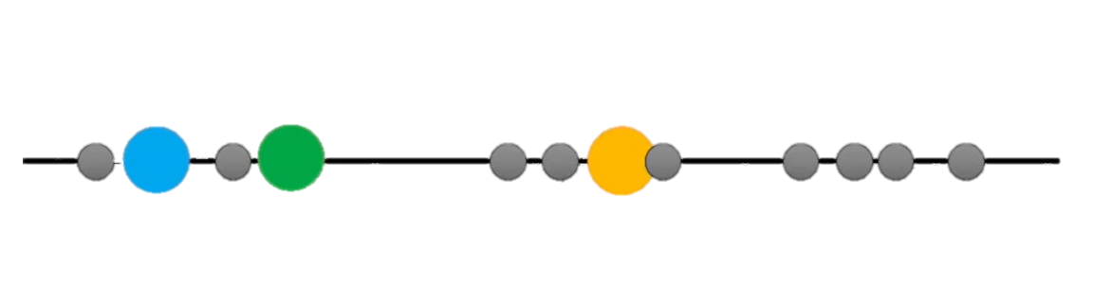
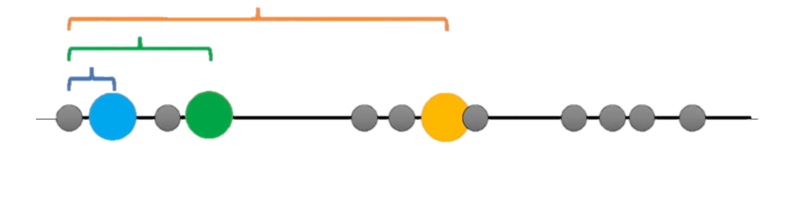
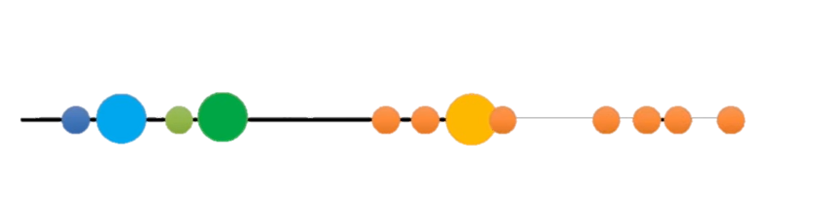
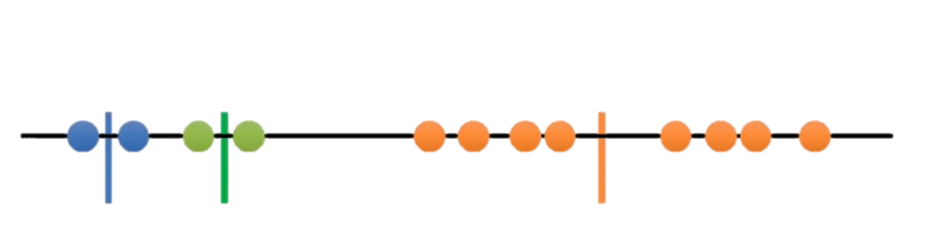
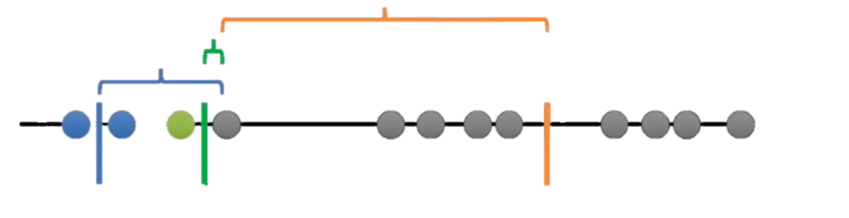
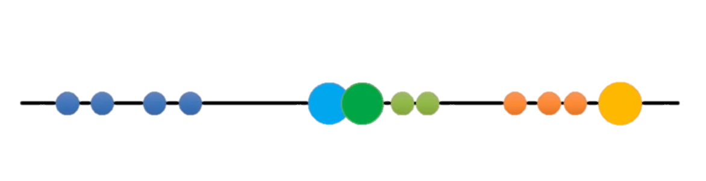
Superpixeles
K-Means
Concept
Set initial centroids
Measure distance of the pixel to the centroids
Pixel will be assigned to the closest centroid
Calculate the mean of the groups
Measure the distance from each pixel to the mean, to get an overall variance
Re-Iterate with new centroids
Best distribution would be the one with lower overall variance.

Slide 5
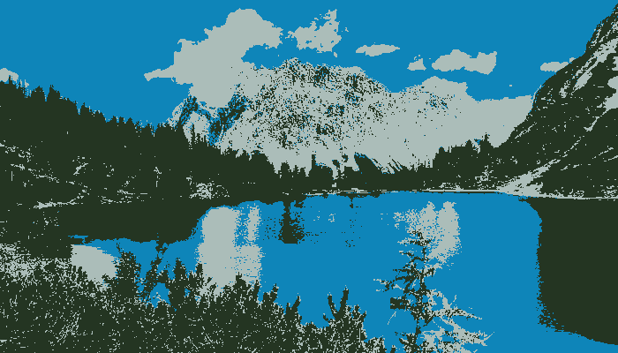
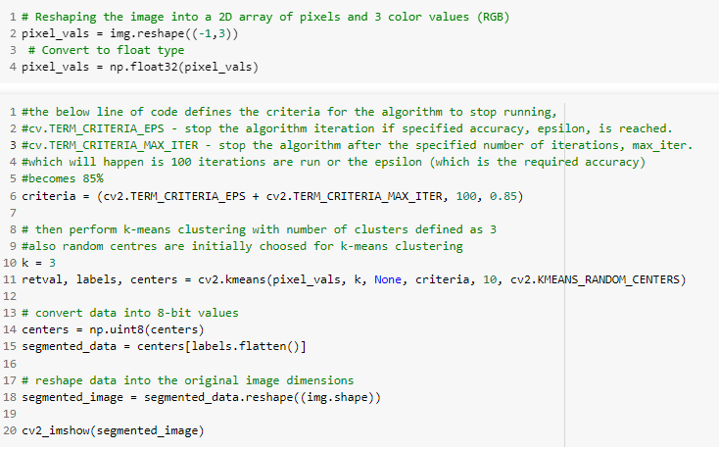
Superpixeles
K-Means
Code

Slide 6
Superpixeles
K-Means
Code Output

Slide 7
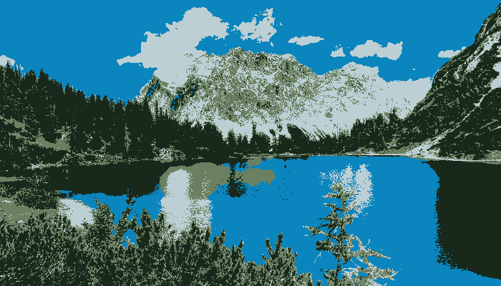
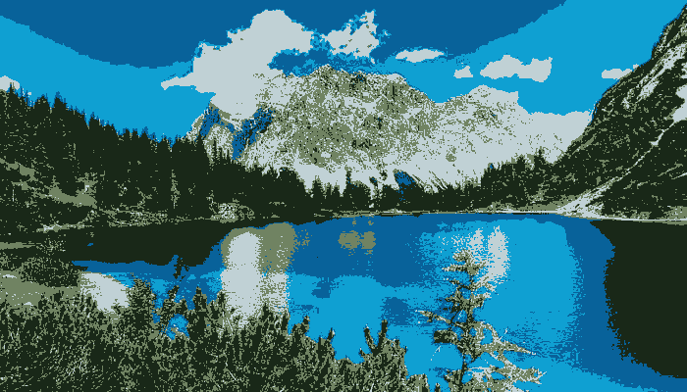
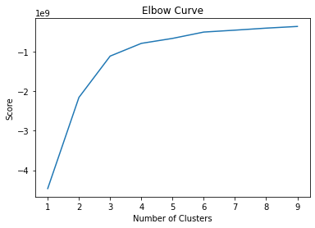
Superpixeles
K-Means
Playing with parameters
K
K =3
K =4
K =5

Slide 8
Superpixeles
SLIC
Simple Linear Iterative Clustering
Concept
Compute initial cluster centers m
Sample image into regular grid steps S
S= sqrt (number of pixels/number of Super pixels)
Assign samples to cluster centers
Compute distance of m and each pixel within a 2sx2s neighborhood
Update cluster centers
Sum of total pixels divided by number of pixels on the group
Test for convergence
Compute the norm of the difference between mean and pixels
Replace value of pixels with average value m

Slide 9
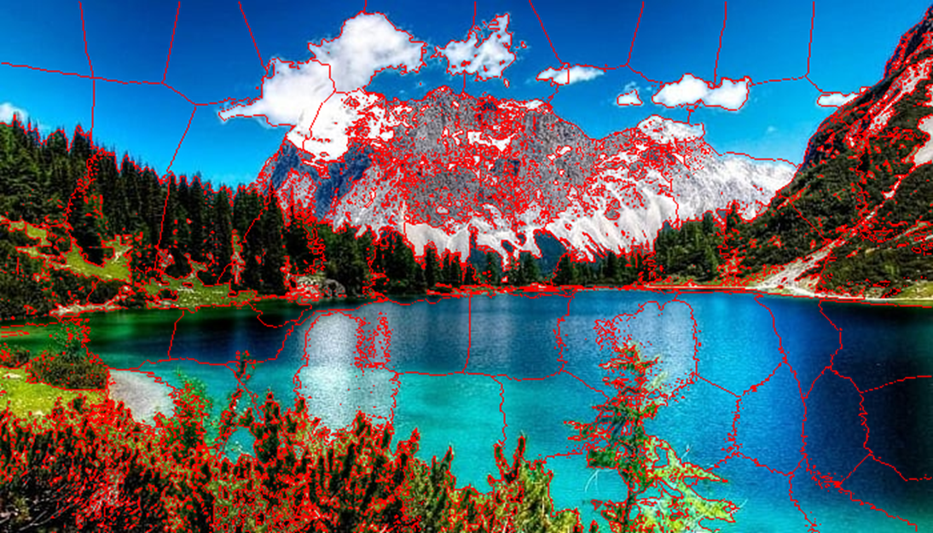
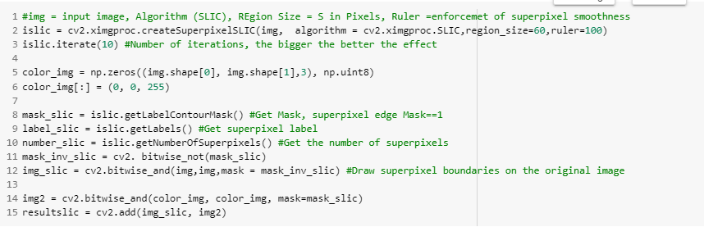
Superpixeles
SLIC
OpenCV

Slide 10
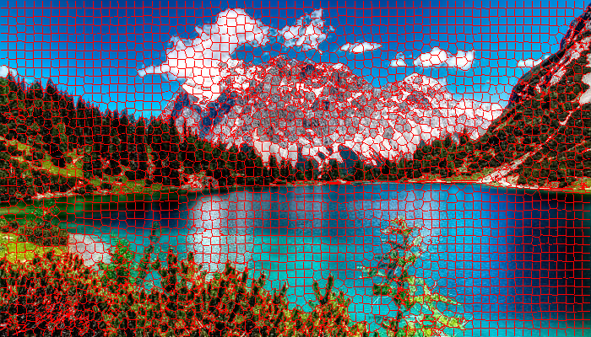
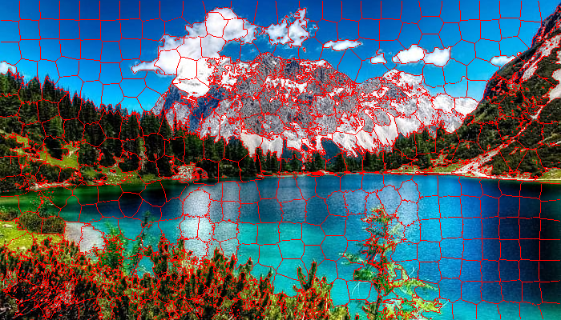

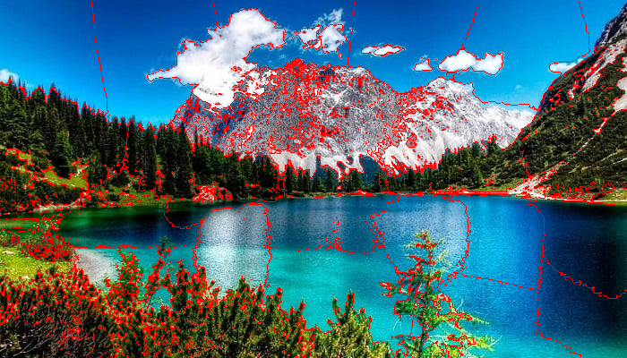
Superpixeles
SLIC
Playing with parameters
Region Size
Region size =10. Number of superpixels 2800
Region size =25. Number of superpixels 448
Region size =50. Number of superpixels 112
Region size =100. Number of superpixels 28

Slide 11
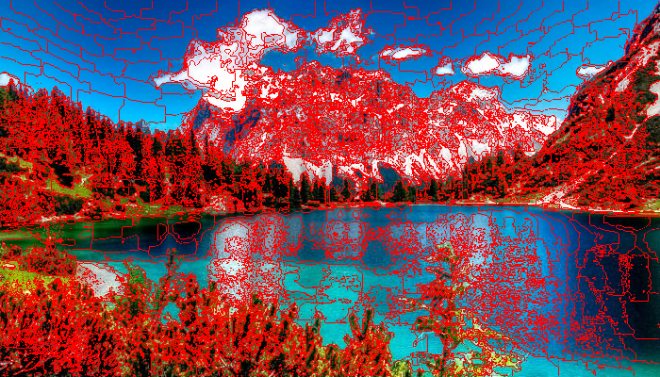
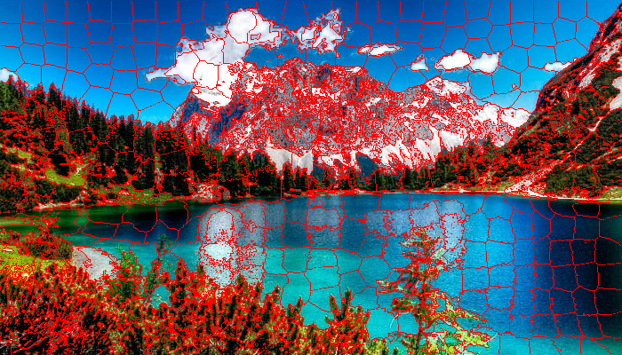
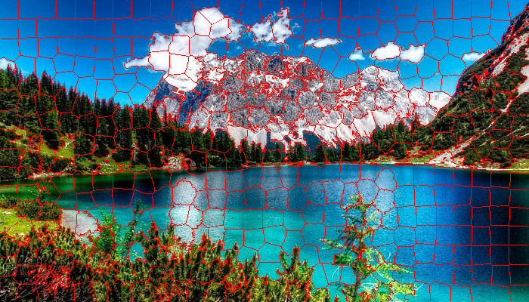
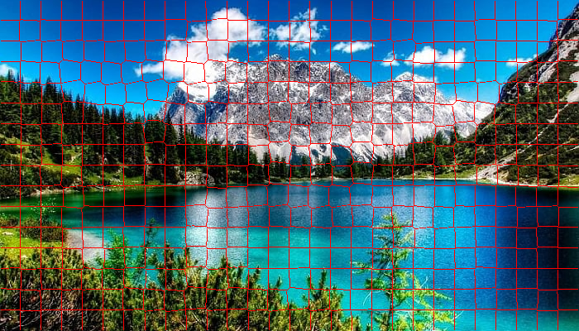
Superpixeles
SLIC
Playing with parameters
Ruler
Ruler =1
Ruler = 64
Ruler = 160
Ruler = 1024

Slide 12
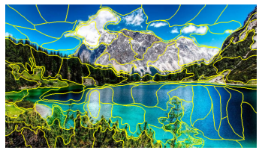
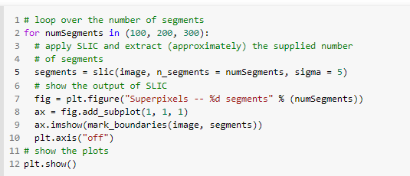
Superpixeles
SLIC
Skimage

Slide 13

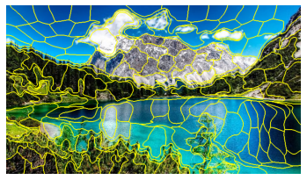
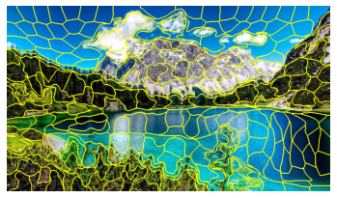
Superpixeles
SLIC
Playing with parameters
Number of segments
numSegments = 100
numSegments = 200
numSegments =300

Slide 14
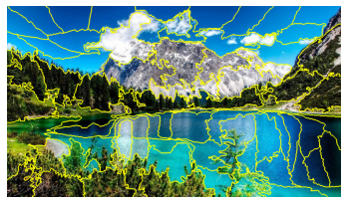
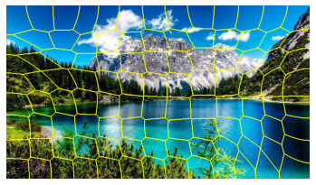

Superpixeles
SLIC
Playing with parameters
Sigma
Sigma 1
Sigma = 64
sigma =255

Slide 15
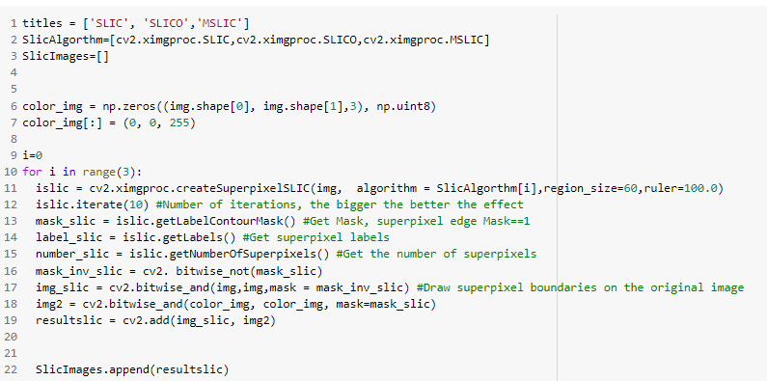
Superpixeles
SLIC
SLIC SLICO MSLIC

Slide 16
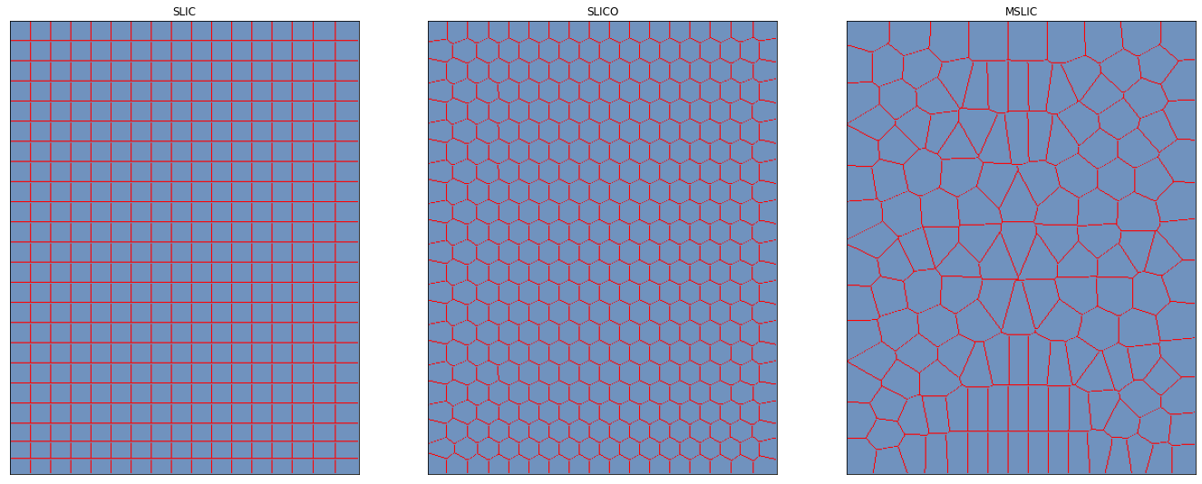
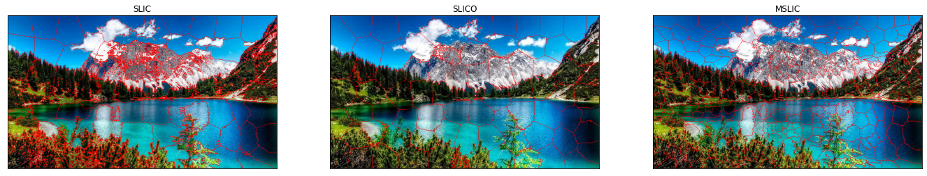
SLIC

Slide 17

Maestria en Inteligencia Artificial Aplicada
Ciencia y Analítica de Datos
Dr Gilberto Ochoa
Proyecto Final: Métodos de Segmentación Superpixeles
Alberto Nieves Cisneros A01793829
Aurelio Antonio Lozano Rábago A01081266
Héctor Manuel González Villareal A00178679
Jessica Lechuga Ramos A01793512
Luis Alfredo Negron Naldos A01793865

Slide 18

Superpixeles
Agruáción de pixeles conectados con caracteísticas similates en reciones perceptualmente significativas
Costo computacional
Mejora desempeño
Evita cuadridiculado

Slide 19
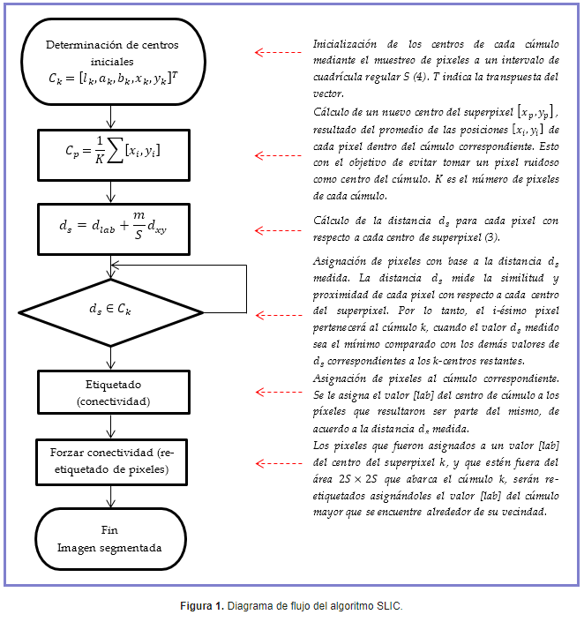
Superpixeles

